Slide 1
How to Write a Biography
A detailed description or account of someone’s life written by someone else.

Slide 2
Biographies analyse and interpret the events in a person's life.
‘The purpose of a biography is to report on a person’s life in an informative and exciting manner. At the end of a biography, the reader should feel that they know the subject on a personal level’.
Source http://www.exampleessays.com/viewpaper/2233.html
Many biographies are written in chronological order.

Slide 3
Biographers use primary & secondary sources:
Primary sources are material from or directly related to the past (eg letters, diaries, newspapers or photographs)
Secondary sources are documents which discusses information originally presented elsewhere. (eg other biographies, reference books, textbooks & journals)

Slide 4
To write a Biography you should:
Find out the basic facts of the person's life. Start with a reliable internet search engine.
Think about what else you would like to know about the person, and what parts of their life you want to write most about. (ie If your assessment is about being famous, you will need to write more about the famous events which this person was involved in.

Slide 5
FORMAT: A Beginning -
Introducing the person
  Name
  Birth date
  What makes this person famous?
  Statement about who they are and why they are known.

Slide 6
A Middle -
Write about some highlights of the person's life.
  Describe and discuss their early life.
  What events shaped or changed this person’s life?
  Did he or she overcome any obstacles?
  What examples from their life illustrate their famous qualities?

Slide 7
An Ending -
Explain why you wrote about this person and make conclusions about this person's life.
  What kind of effect did he or she have on the world? Other people?
  Were this person’s accomplishments recognised? How?
  Would the world be better or worse if this person hadn’t lived? How and why?

Slide 8
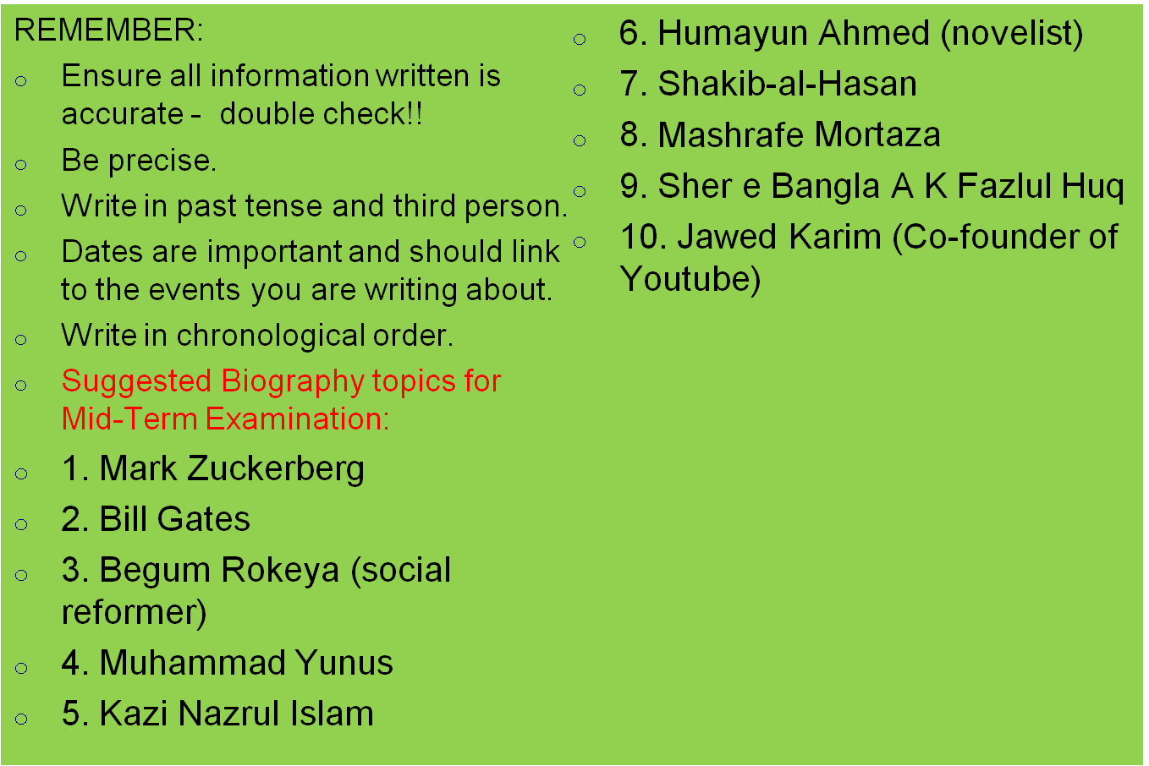
Your Biography Assessment

Slide 9



